Slide 1

Objectives
Understand the concepts of hierarchical memory organization.
Understand how each level of memory contributes to system performance, and how the performance is measured.

Slide 2
Introduction
Memory lies at the heart of the stored-program computer.
In previous chapters, we studied the components from which memory is built and the ways in which memory is accessed by various ISAs.
In these slides, we focus on memory organization. A clear understanding of these ideas is essential for the analysis of system performance.

Slide 3
Types of Memory (1 of 2)
There are two kinds of main memory: random access memory (RAM) and read-only-memory (ROM).
There are two types of RAM: dynamic RAM (DRAM) and static RAM (SRAM).
DRAM consists of capacitors that slowly leak their charge over time. Thus, they must be refreshed every few milliseconds to prevent data loss.
DRAM is “cheap” memory owing to its simple design.

Slide 4
Types of Memory (2 of 2)
SRAM consists of circuits similar to the D flip-flop that we studied before.
SRAM is very fast memory and it doesn’t need to be refreshed like DRAM does. It is used to build cache memory, which we will discuss in detail later.
ROM also does not need to be refreshed, either. In fact, it needs very little charge to retain its memory.
ROM is used to store permanent, or semi-permanent data that persists even while the system is turned off.

Slide 5
The Memory Hierarchy (1 of 6)
Generally speaking, faster memory is more expensive than slower memory.
To provide the best performance at the lowest cost, memory is organized in a hierarchical fashion.
Small, fast storage elements are kept in the CPU, larger, slower main memory is accessed through the data bus.
Larger, (almost) permanent storage in the form of disk and tape drives is still further from the CPU.

Slide 6
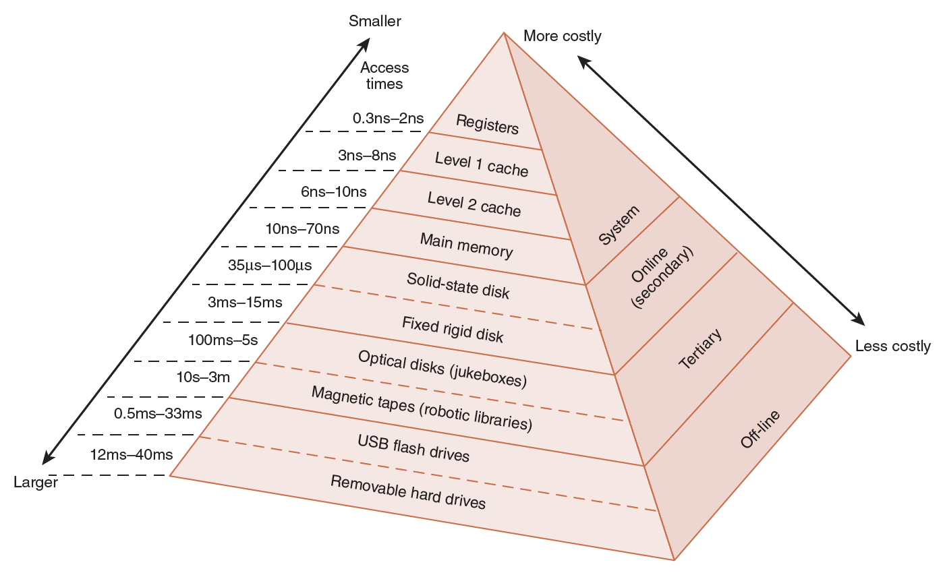
The Memory Hierarchy (2 of 6)
This storage organization can be thought of as a pyramid:

Slide 7
The Memory Hierarchy (3 of 6)
We are most interested in the memory hierarchy that involves registers, cache, main memory, and virtual memory.
Registers are storage locations available on the processor itself.
Virtual memory is typically implemented using a hard drive; it extends the address space from RAM to the hard drive.
Virtual memory provides more space: Cache memory provides speed.

Slide 8
The Memory Hierarchy (4 of 6)
To access a particular piece of data, the CPU first sends a request to its nearest memory, usually cache.
If the data is not in cache, then main memory is queried. If the data is not in main memory, then the request goes to disk.
Once the data is located, then the data and a number of its nearby data elements are fetched into cache memory.

Slide 9
The Memory Hierarchy (5 of 6)
This leads us to some definitions.
A hit is when data is found at a given memory level.
A miss is when it is not found.
The hit rate is the percentage of time data is found at a given memory level.
The miss rate is the percentage of time it is not.
Miss rate = 1 – hit rate.
The hit time is the time required to access data at a given memory level.
The miss penalty is the time required to process a miss, including the time that it takes to replace a block of memory plus the time it takes to deliver the data to the processor.

Slide 10
The Memory Hierarchy (6 of 6)
An entire block of data is copied after a hit because the principle of locality tells us that once a byte is accessed, it’s likely that a nearby data element will be needed soon.
There are three forms of locality:
Temporal locality: Recently-accessed data elements tend to be accessed again.
Spatial locality: Accesses tend to cluster.
Sequential locality: Instructions tend to be accessed sequentially.

Slide 11
Cache Memory
The purpose of cache memory is to speed up accesses by storing recently used data closer to the CPU, instead of storing it in main memory.
Although cache is much smaller than main memory, its access time is a fraction of that of main memory.
Unlike main memory, which is accessed by address, cache is typically accessed by content; hence, it is often called content addressable memory.
Because of this, a single large cache memory isn’t always desirable—it takes longer to search.

Slide 12
Cache Memory
The simplest cache mapping scheme is direct mapped cache.
In a direct mapped cache consisting of N blocks of cache, block X of main memory maps to cache block Y = X mod N.
Thus, if we have 10 blocks of cache, block 7 of cache may hold blocks 7, 17, 27, 37, . . . of main memory.
The next slide illustrates this mapping concept.

Slide 13
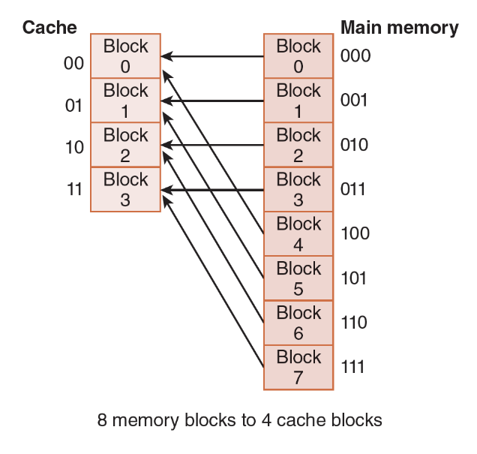
Cache Memory
With direct mapped cache consisting of 4 blocks of cache, block X of main memory maps to cache block Y = X mod 4.

Slide 14
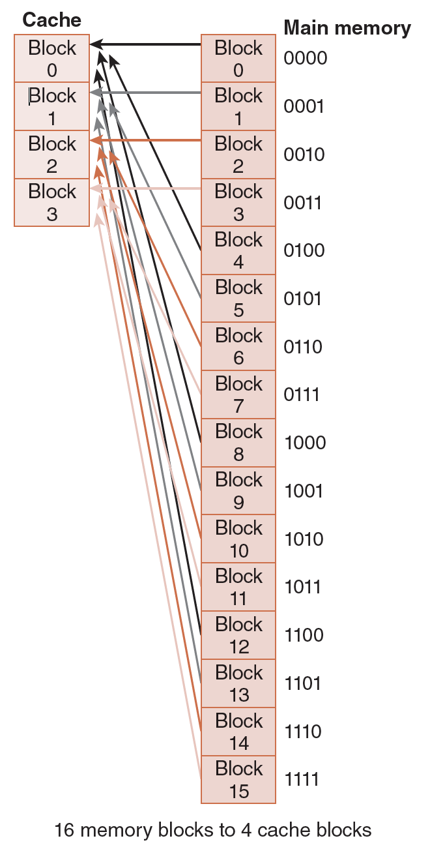
Cache Memory
A larger example.

Slide 15
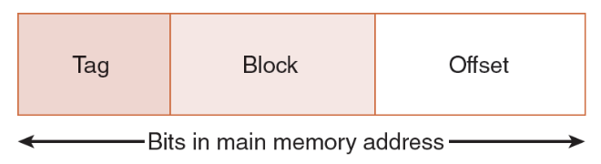
Cache Memory
To perform direct mapping, the binary main memory address is partitioned into the fields shown below.
The offset field uniquely identifies an address within a specific block.
The block field selects a unique block of cache.
The tag field is whatever is left over.
The sizes of these fields are determined by characteristics of both memory and cache.

Slide 16
Cache Memory
Example 1: Consider a byte-addressable main memory consisting of 4 blocks, and a cache with 2 blocks, where each block is 4 bytes.
This means Block 0 and 2 of main memory map to Block 0 of cache, and Blocks 1 and 3 of main memory map to Block 1 of cache.
Using the tag, block, and offset fields, we can see how main memory maps to cache as follows.

Slide 17
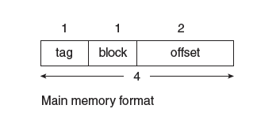
Cache Memory
Example 1: Cont’d. Consider a byte-addressable main memory consisting of 4 blocks, and a cache with 2 blocks, where each block is 4 bytes.
First, we need to determine the address format for mapping. Each block is 4 bytes, so the offset field must contain 2 bits; there are 2 blocks in cache, so the block field must contain 1 bit; this leaves 1 bit for the tag (as a main memory address has 4 bits because there are a total of 2⁴ = 16 bytes).

Slide 18
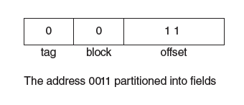
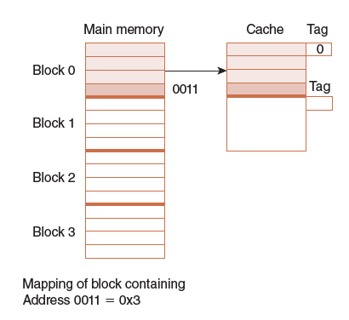
Cache Memory
Example 1: Cont’d.
Suppose we need to access main memory address 3₁₆ (0x0011 in binary). If we partition 0x0011 using the address format from Figure a, we get Figure b.
Thus, the main memory address 0x0011 maps to cache block 0.
Figure c shows this mapping, along with the tag that is also stored with the data.
The next slide illustrates another mapping.

Slide 19
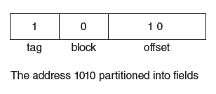
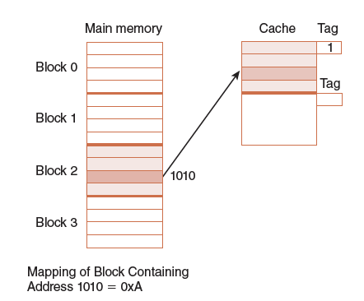
Cache Memory

Slide 20

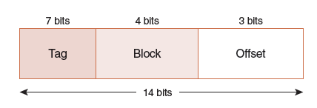
Cache Memory
Example 2: Assume a byte-addressable memory consists of 2¹⁴ bytes, cache has 16 blocks, and each block has 8 bytes.
The number of memory blocks are:
Each main memory address requires 14 bits. Of this 14-bit address field, the rightmost 3 bits reflect the offset field.
We need 4 bits to select a specific block in cache, so the block field consists of the middle 4 bits.
The remaining 7 bits make up the tag field.

Slide 21
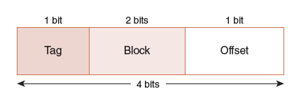
Cache Memory
Example 3: Assume a byte-addressable memory consisting of 16 bytes divided into 8 blocks. Cache contains 4 blocks. We know:
A memory address has 4 bits.
The 4-bit memory address is divided into the fields below.

Slide 22
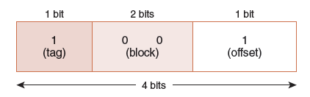
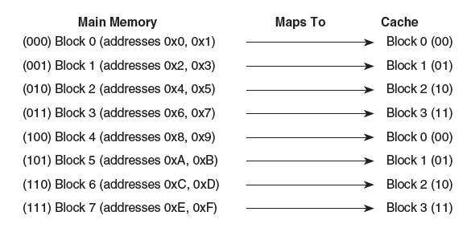
Cache Memory
Example 3: Cont’d. The mapping for memory references is shown below:

Slide 23
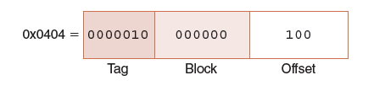
Cache Memory
Example 4: Consider 16-bit memory addresses and 64 blocks of cache where each block contains 8 bytes. We have:
3 bits for the offset
6 bits for the block
7 bits for the tag
A memory reference for 0x0404 maps as follows:

Slide 24
Cache Memory
In summary, direct mapped cache maps main memory blocks in a modular fashion to cache blocks. The mapping depends on:
The number of bits in the main memory address (how many addresses exist in main memory).
The number of blocks are in cache (which determines the size of the block field).
How many addresses (either bytes or words) are in a block (which determines the size of the offset field).

Slide 25
Cache Memory
Suppose instead of placing memory blocks in specific cache locations based on memory address, we could allow a block to go anywhere in cache.
In this way, cache would have to fill up before any blocks are evicted.
This is how fully associative cache works.

Slide 26
Cache Memory
The performance of hierarchical memory is measured by its effective access time (EAT).
EAT is a weighted average that takes into account the hit ratio and relative access times of successive levels of memory.
The EAT for a two-level memory is given by:
EAT = H × Access_{C} + (1 – H) × Access_{MM}
where H is the cache hit rate and Access_{C} and Access_{MM} are the access times for cache and main memory, respectively.

Slide 27
Cache Memory
For example, consider a system with a main memory access time of 200ns supported by a cache having a 10ns access time and a hit rate of 99%.
Suppose access to cache and main memory occurs concurrently (the accesses overlap).
The EAT is:
0.99(10ns) + 0.01(200ns) = 9.9ns + 2ns = 11ns

Slide 28
Cache Memory
If the accesses do not overlap, the EAT is:
0.99(10ns) + 0.01(10ns + 200ns)
= 9.9ns + 2.01ns = 12ns
This equation for determining the effective access time can be extended to any number of memory levels.

Slide 29
Cache Memory
Caching is depends upon programs exhibiting good locality.
Some object-oriented programs have poor locality owing to their complex, dynamic structures.
Arrays stored in column-major rather than row-major order can be problematic for certain cache organizations.
With poor locality, caching can actually cause performance degradation rather than performance improvement.

Slide 30
Cache Memory
Most of today’s small systems employ multilevel cache hierarchies.
The levels of cache form their own small memory hierarchy.
Level 1 cache (8KB to 64KB) is situated on the processor itself.
Access time is typically about 4ns.
Level 2 cache (64KB to 2MB) may be on the motherboard, or on an expansion card.
Access time is usually around 15–20ns.

Slide 31
Cache Memory
In systems that employ three levels of cache, the Level 2 cache is placed on the same die as the CPU (reducing access time to about 10ns).
Accordingly, the Level 3 cache (2MB to 256MB) refers to cache that is situated between the processor and main memory.
Once the number of cache levels is determined, the next thing to consider is whether data (or instructions) can exist in more than one cache level.

Slide 32
Conclusion
Computer memory is organized in a hierarchy, with the smallest, fastest memory at the top and the largest, slowest memory at the bottom.
Cache memory gives faster access to main memory, while virtual memory uses disk storage to give the illusion of having a large main memory.
Cache maps blocks of main memory to blocks of cache memory. Virtual memory maps page frames to virtual pages.

